Slide 1

Music Mood & Listening Behavior Analysis SQL Project
Presented By
Mahesh Sanjay Kalambe

Slide 2
Problem Statement
With the rapid growth of online music streaming platforms, understanding user behavior, preferences, and listening patterns has become essential for improving user engagement and personalization.
Music platforms often struggle to analyze massive amounts of listening data to uncover trends such as:
What moods or genres are most popular?
Which artists are trending in specific countries?
How do listening habits change based on time, mood, or device?
Which users are the most active or diverse listeners?
This project aims to design and analyze a Music Mood & Listening Behavior Analytics System using SQL to store, manage, and analyze music streaming data effectively.

Slide 3
Objective
To build a relational SQL database system that can:
Store information about users, songs, moods, genres, devices, and listening history.
Analyze user listening behavior to uncover insights and trends.
Generate analytical queries to support business decisions and personalization strategies.

Slide 4
Database Overview
Tables Used:
Users – stores details of listeners (name, age, country).
Songs – contains song info (title, artist, genre, mood, duration).
Genres – list of music genres (Pop, Rock, Jazz, etc.).
Moods – list of moods (Happy, Sad, Chill, Energetic, etc.).
Devices – stores listening device types (Mobile, Desktop, Smart Speaker, etc.).
ListeningHistory – logs each song played by each user (with timestamp and device).

Slide 5
Key Questions to Answer (Analytics Goals):
Which songs, artists, or genres are the most popular?
What are the most common listening moods for different users or regions?
Which users are the most active listeners?
What devices are most used for listening?
Which time of day or week has the highest listening activity?
Are certain moods or genres more popular in specific countries?
Which artists have the widest global reach?
What patterns exist in repeated listening behavior?

Slide 6
SQL QUERY
Create Database Music;
Use Music;
Table Users
CREATE TABLE Users(user_id INT PRIMARY KEY,
name VARCHAR(100),age INT,country VARCHAR(100));
Table Generes
CREATE TABLE Genres (genre_id INT PRIMARY KEY,
genre_name VARCHAR(100));
Table Moods
CREATE TABLE Moods
(mood_id INT PRIMARY KEY,mood_name VARCHAR(100));
Table Devices
CREATE TABLE Devices
(device_id INT PRIMARY KEY,device_name VARCHAR(100));

Slide 7
Table Songs
CREATE TABLE Songs (song_id INT PRIMARY KEY,title VARCHAR(100),artist VARCHAR(100),genre_id INT,mood_id INT,duration INT,FOREIGN KEY (genre_id) REFERENCES Genres(genre_id),FOREIGN KEY (mood_id) REFERENCES Moods(mood_id)
);
Table ListeningHistory
CREATE TABLE ListeningHistory (history_id INT PRIMARY KEY,user_id INT,song_id INT,device_id INT,listen_time DATETIME,FOREIGN KEY (user_id) REFERENCES Users(user_id),FOREIGN KEY (song_id) REFERENCES Songs(song_id),FOREIGN KEY (device_id) REFERENCES Devices(device_id)
);

Slide 8
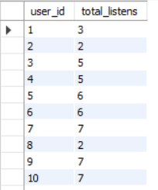
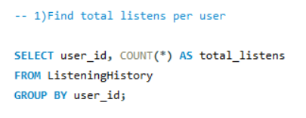
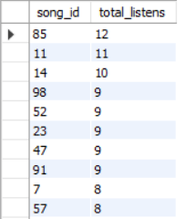
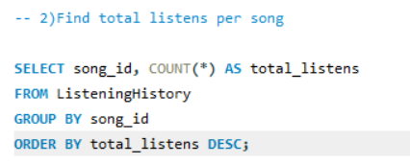
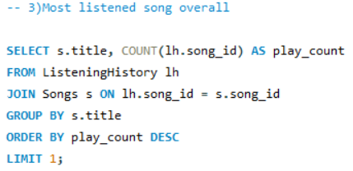


Slide 9
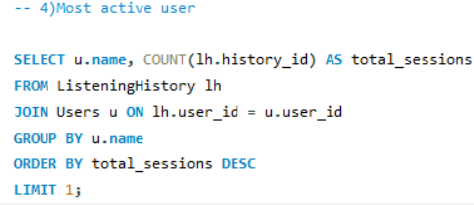

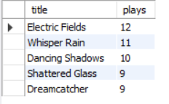
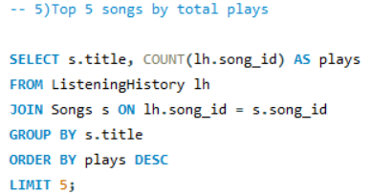
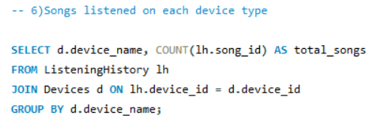
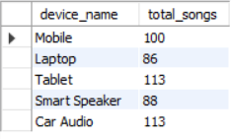

Slide 10
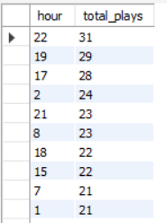
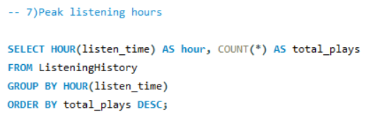
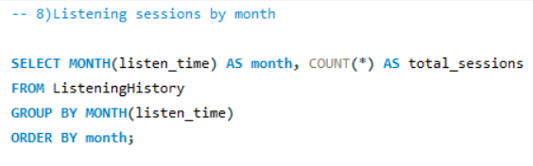
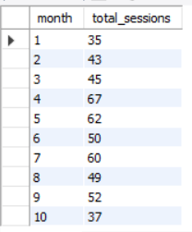
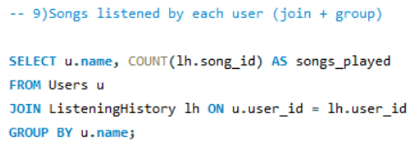
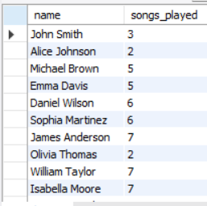

Slide 11
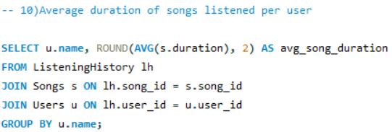
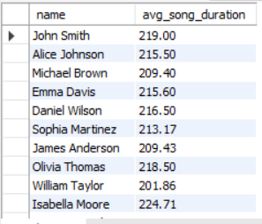
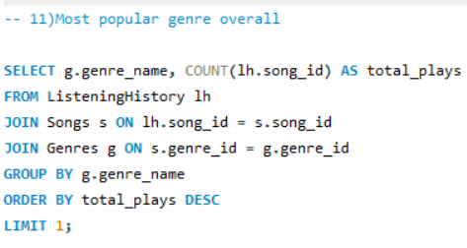

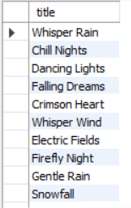
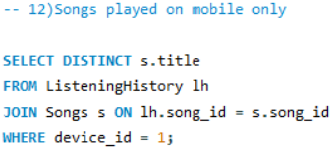

Slide 12
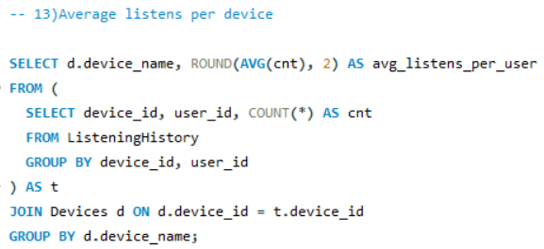
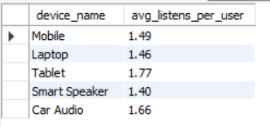
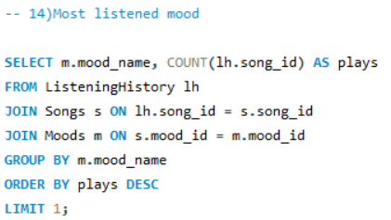

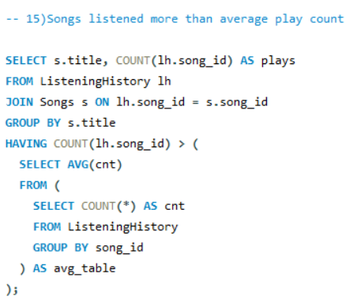
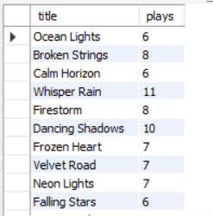

Slide 13
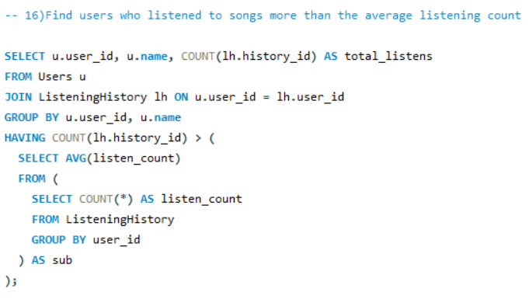
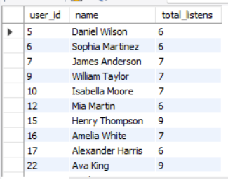
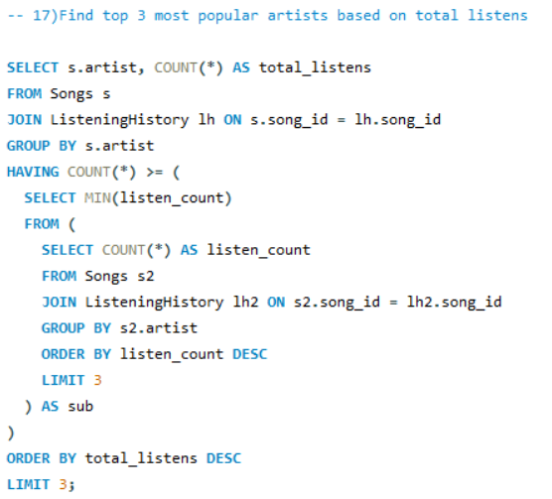
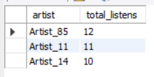

Slide 14
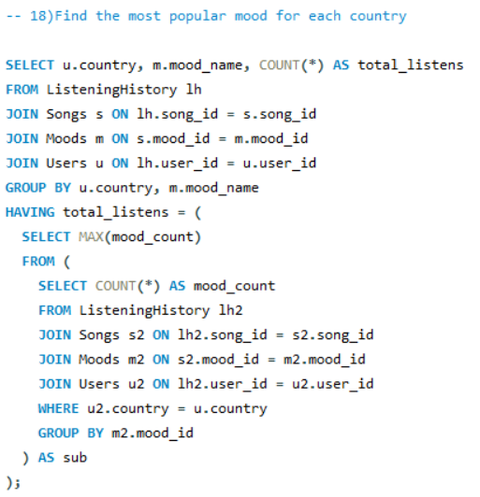
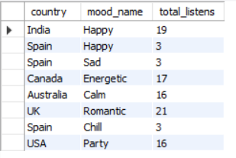
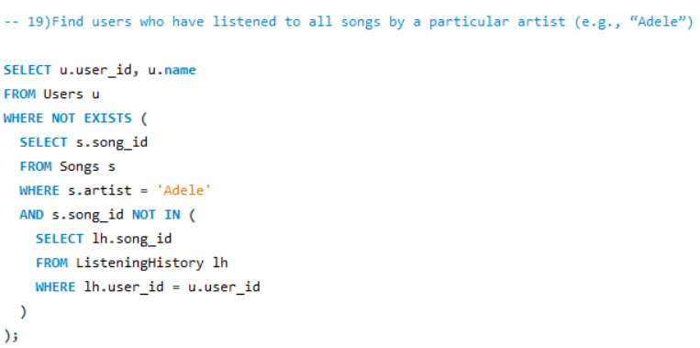
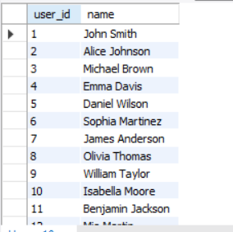

Slide 15
